Slide 1
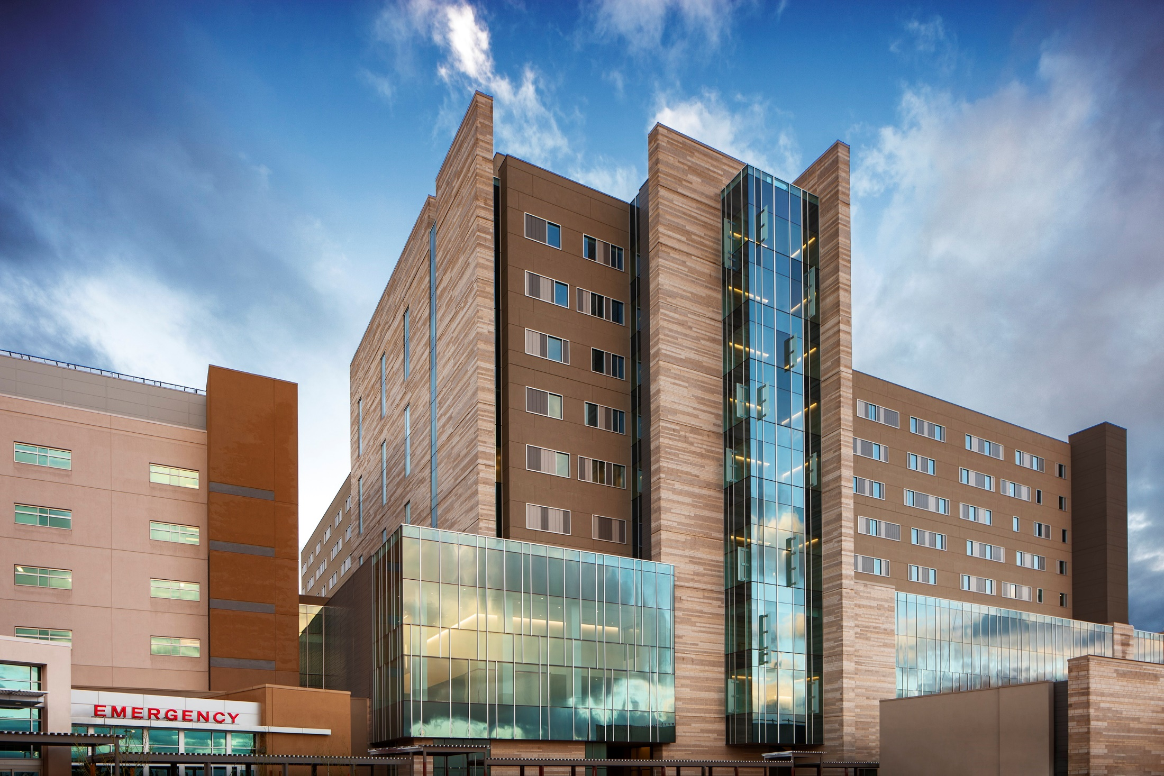
Department of Obstetrics and Gynecology
University of Arizona Health Sciences

Slide 2
One of the largest nonprofit hospital systems in the country (Arizona, California, Colorado, Nebraska, Nevada and Wyoming)
30 acute-care hospitals and a number of other health care entities
With more than 50,000 employees, Banner Health is the largest private employer in Arizona
2023 National Science Foundation rankings:
Top 20 public research institutions (2019 - 2023)
Top 4% of all US Universities in research and development expenditures
#25 in biological and biomedical sciences
Notes:
The NSF's Higher Education Research and Development survey annually ranks more than 900 colleges and universities and is considered the primary source of information on research and development expenditures at U.S. colleges and universities. It matters because we are surrounded by a major think tank and the possibilities for collaboration are endless!

Slide 3
University of Arizona Core Values
Integrity: Be honest, respectful and just
Compassion: Choose to care
Exploration: Be insatiably curious
Adaptation: Stay open-minded and eager for what’s next
Inclusion: We’re better together
Determination: Bear down!

Slide 4
Banner University Medical Center Tucson

Slide 5
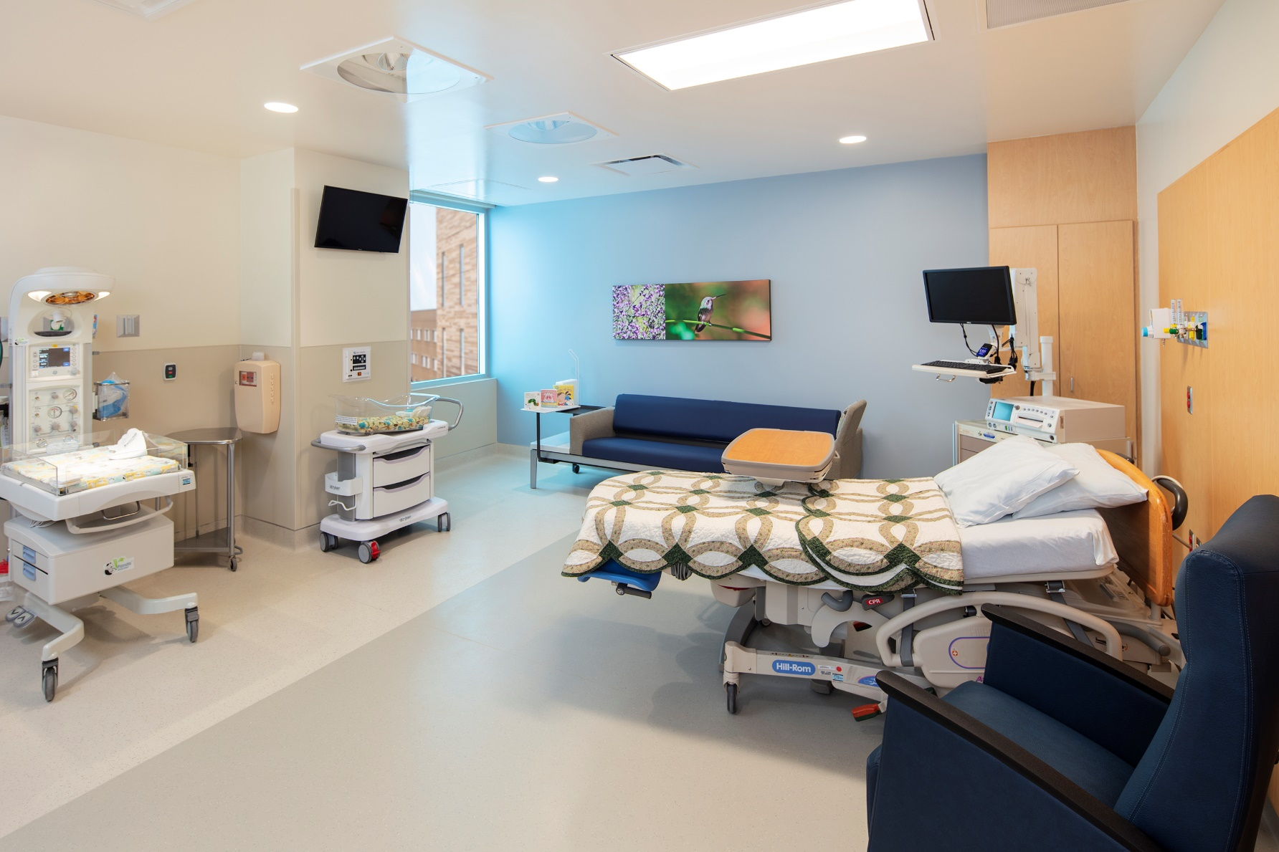
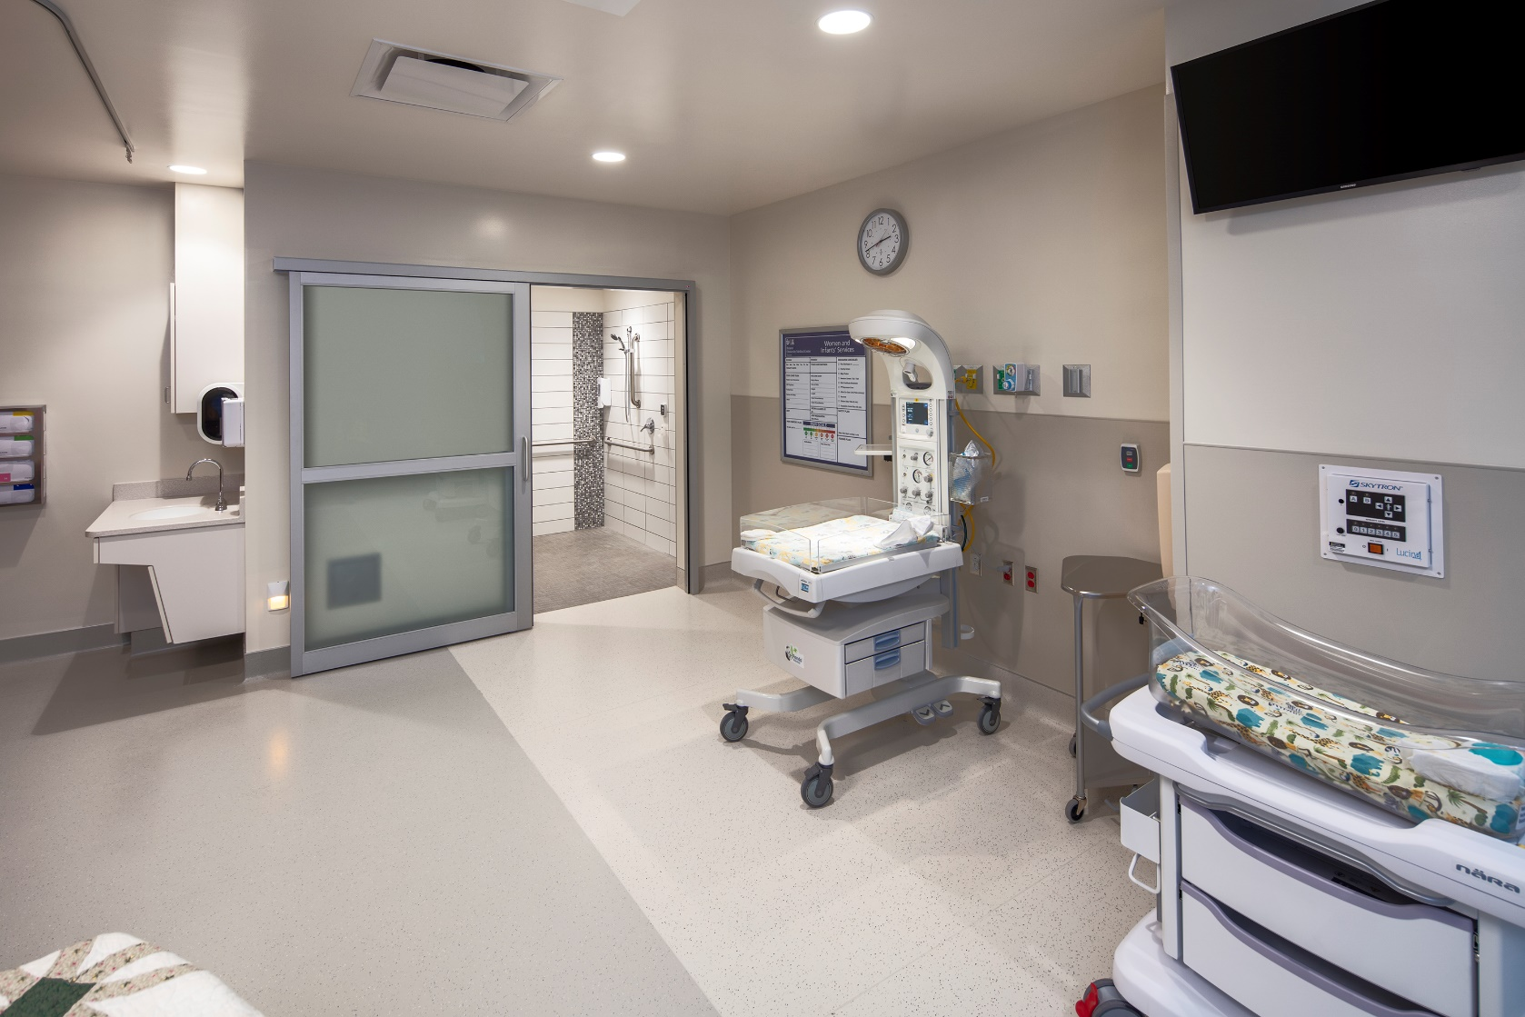
Banner University Medical Center Labor & Delivery
V
MFM FELLOWSHIP| THE UNIVERSITY OF ARIZONA

Slide 6
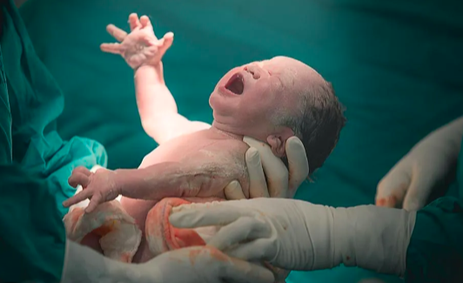
O
Obstetric Volume
250 deliveries / month
6% increase / year since 2019
Facility capacity of 3300 / year

Slide 7
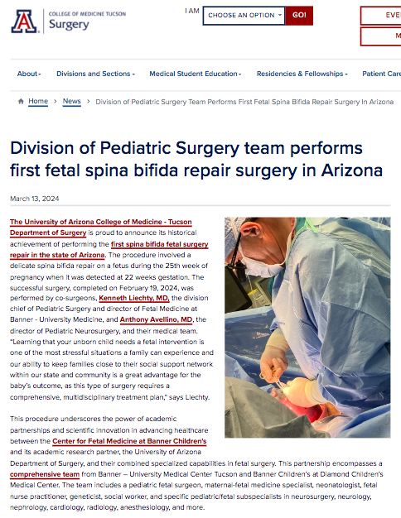
Fetal Surgery Multidisciplinary Team
Fetal/Pediatric surgeon
Maternal fetal medicine specialist
Neonatologist
Genetic counselor
Social worker
Nurse practitioner
Anesthesiologist
Pediatric/fetal subspecialists
Neurosurgery
Neurology
Nephrology
Cardiology
Radiology

Slide 8
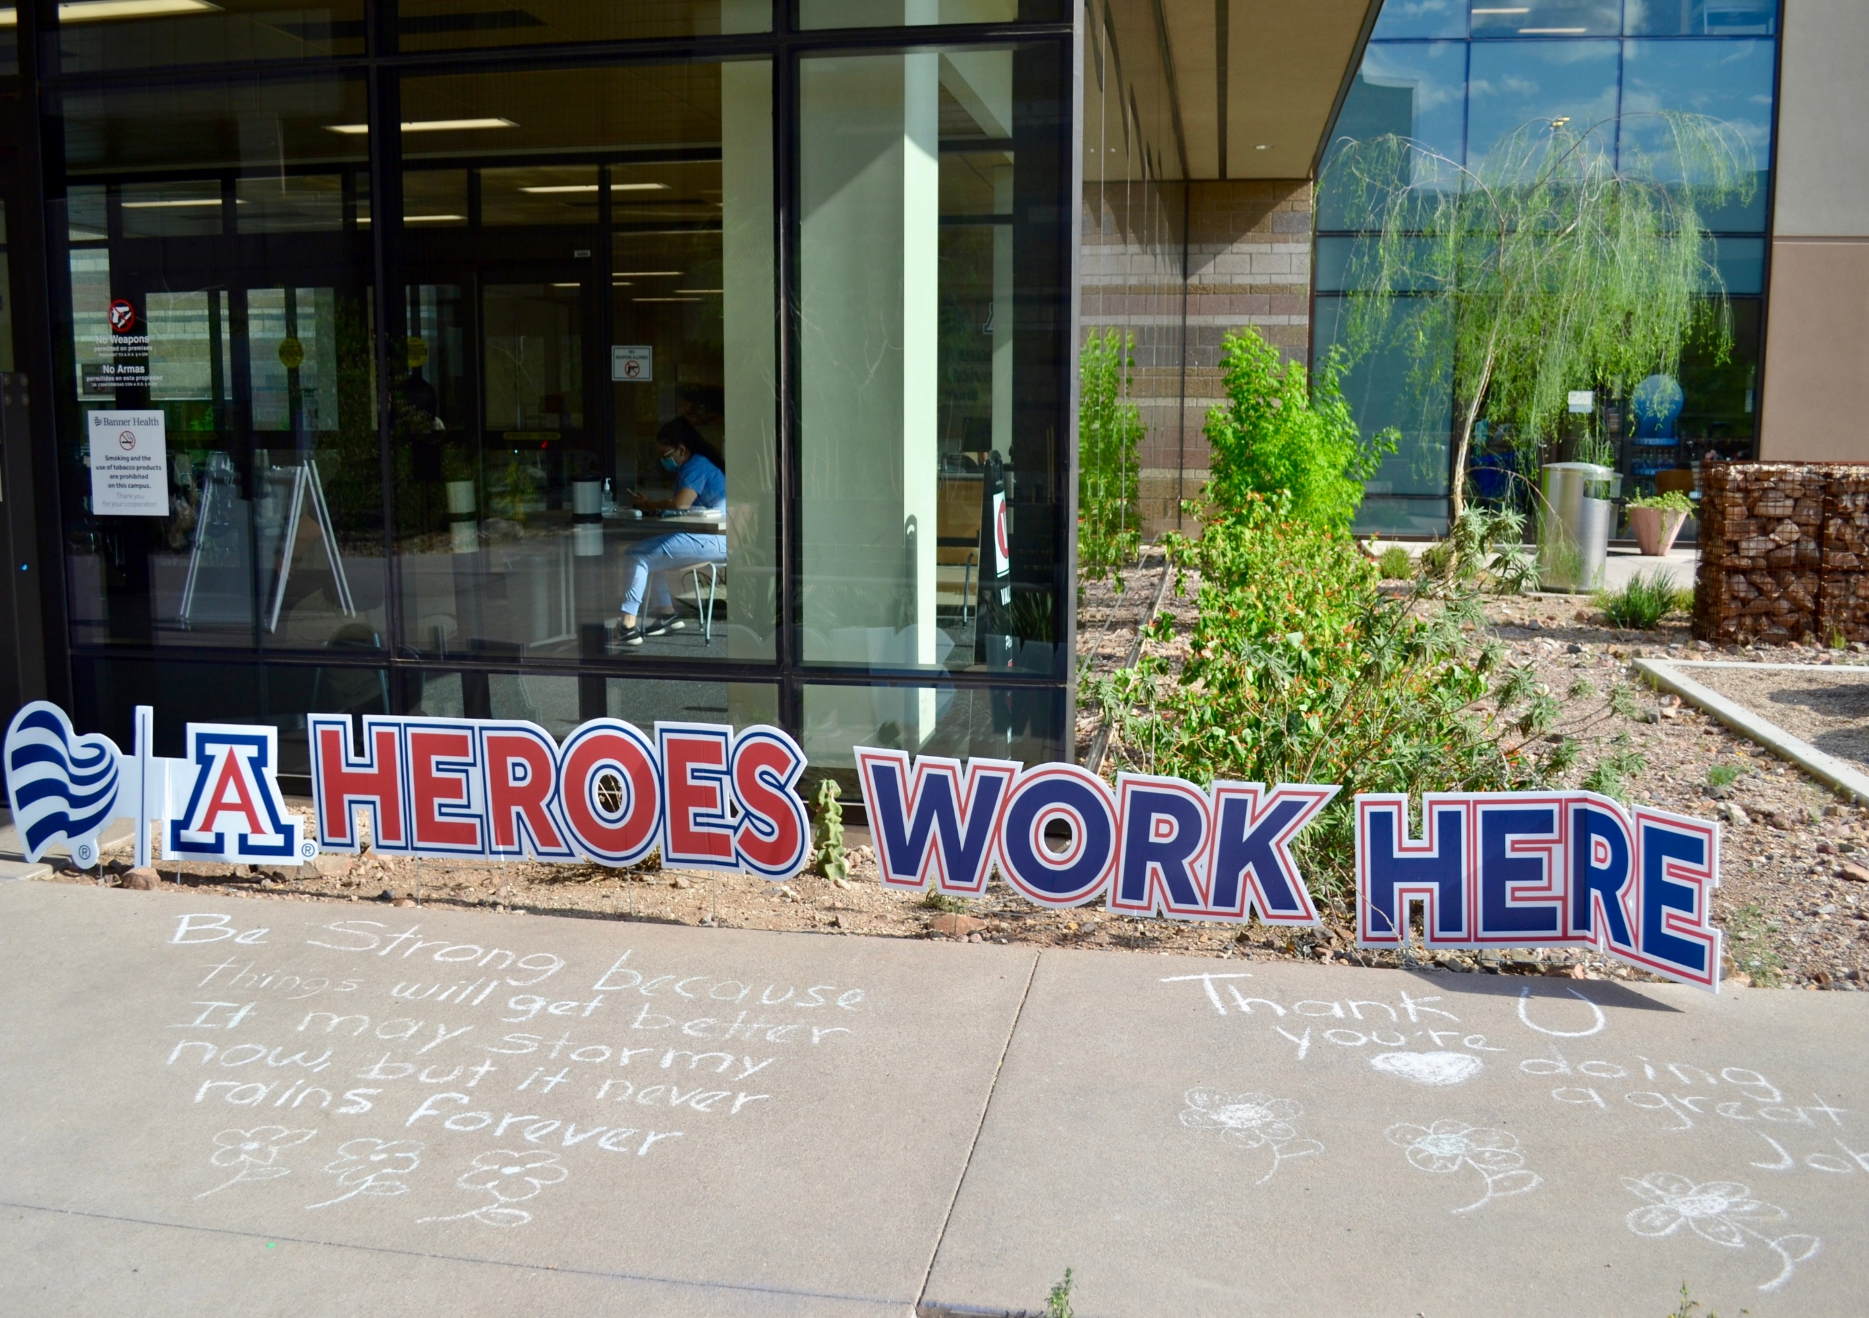

Slide 9
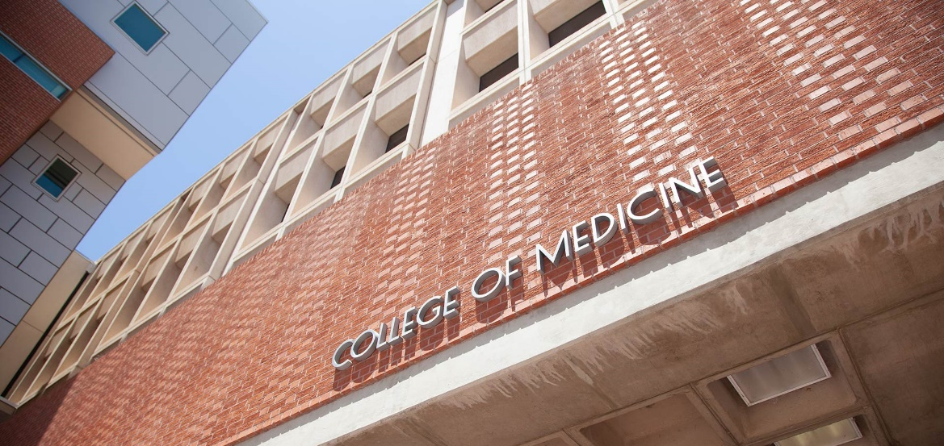
Department of Obstetrics and Gynecology
Maternal-Fetal Medicine

Slide 10
Why choose our fellowship?
Faculty
Research opportunities
High Risk OB referral center for southern AZ
Growing OB volume
Fetal Care Center
Diverse patient population
The ability to write your own story!

Slide 11
Who are we?

Slide 12
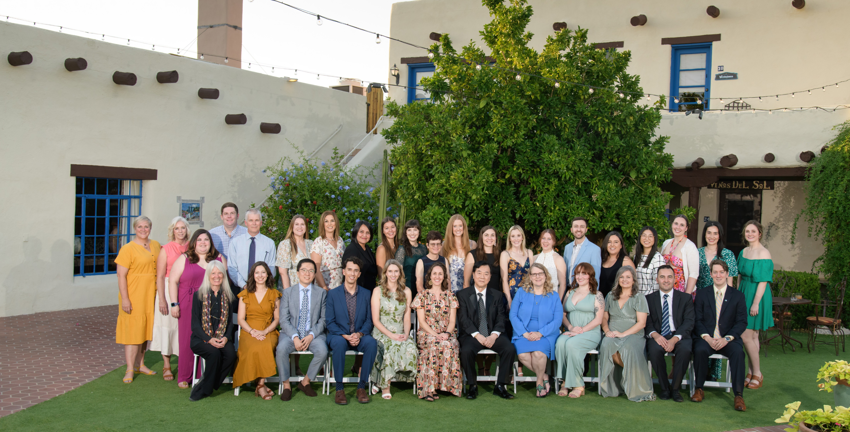
The Department of OB/GYN

Slide 13
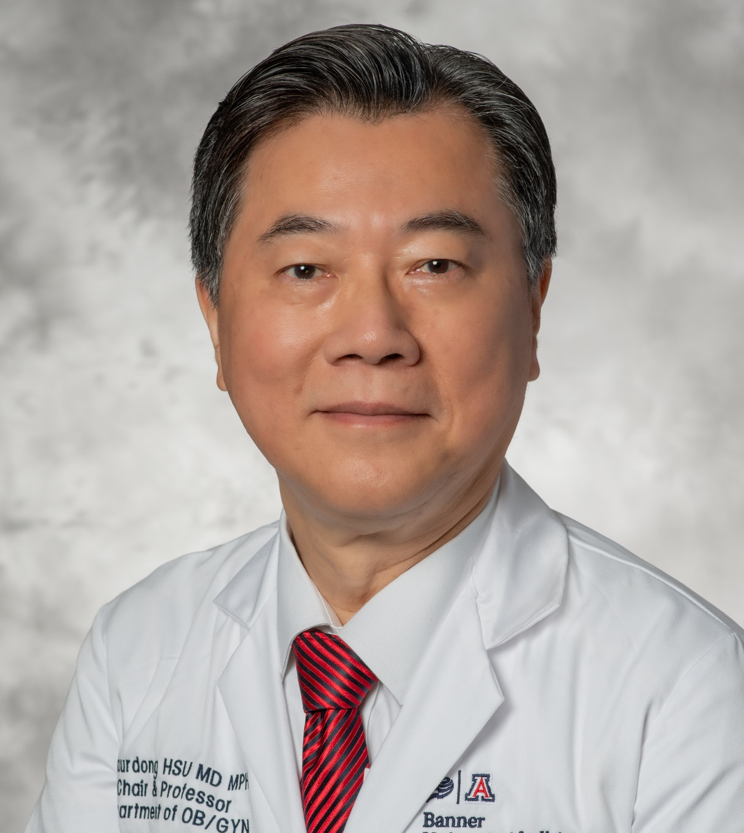
Chaur-Dong Hsu, MD, MPH
Professor & Department Head, Obstetrics & Gynecology
Project Site Consultant, Perinatology Research Branch, NIH
Well funded researcher with nearly 300 publications
Research Interest: Obstetrical syndromes, personalized obstetrics, preeclampsia, intraamniotic infection
Clinical Interest: Complex MFM cases and perinatal ultrasound

Slide 14
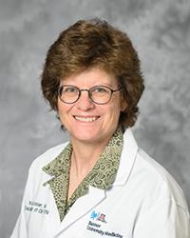
Karen Lesser, MD
Professor, Obstetrics & Gynecology
MFM Division Director
Expertise in management of diabetes in pregnancy
Provides MFM co-management of Fetal Care Center patients
Research Interests: Diabetes in pregnancy; Physical activity and pregnancy outcomes
Clinical Interests: Diabetes in pregnancy; Ultrasound

Slide 15
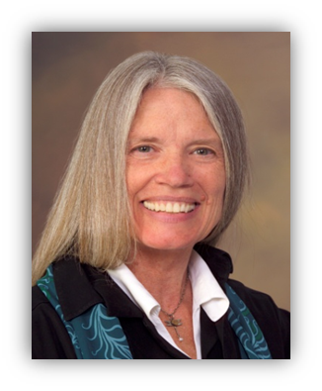
Kathryn Reed, MD
Professor Emeritus, Obstetrics & Gynecology
Served as department chair and fellowship director for may years
Currently provides academic, research, and mentoring support for fellows
Research Interest: Fetal Cardiology, Behavioral Economics, Women in Medicine

Slide 16
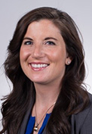
Sarah Kellerhals, MD
Joining October, 2024
Completing MFM fellowship in Phoenix 06/2024
Thesis: Adverse Childhood Experiences and Adverse Community Environments Among Maternal Mortality Cases in Arizona
Clinical Interest: Severe maternal morbidity and mortality; Interpregnancy interval; Perinatal mood disorders

Slide 17
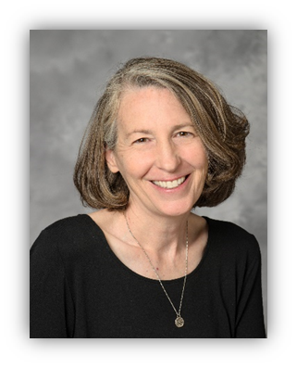
Lynn Coppola, MD, MPH
Interim Fellowship Director
Research: Ultrasound quality assurance for several WHO projects
Clinical Interest: Global and national health care disparities

Slide 18
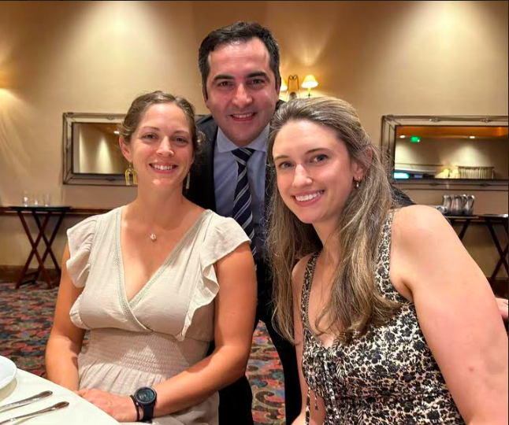
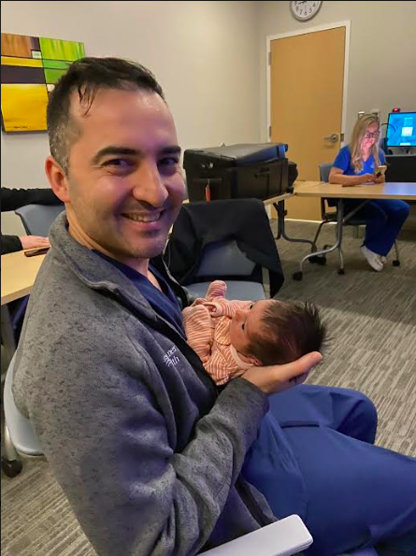
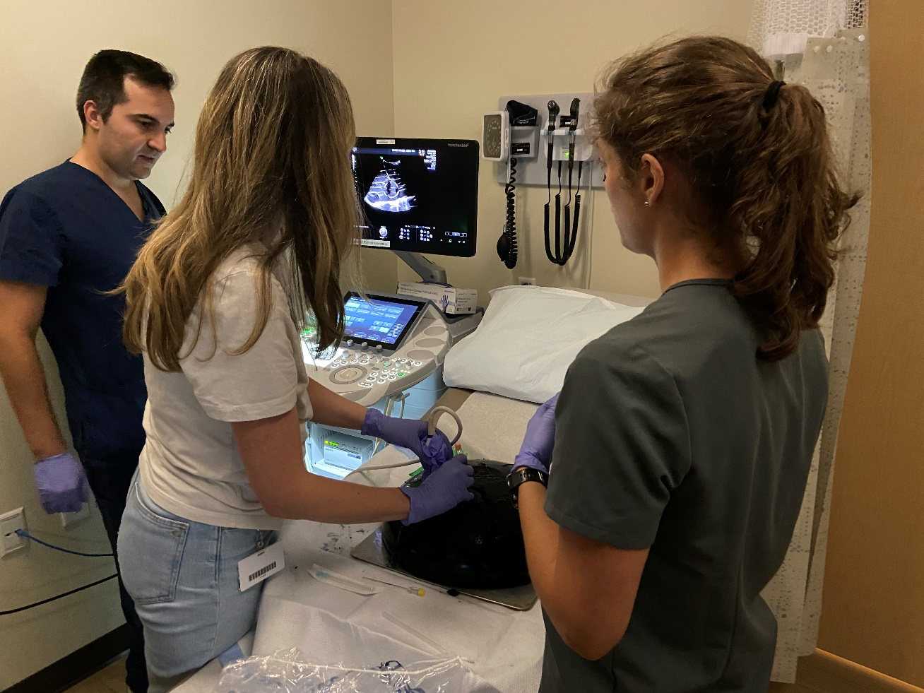
Our Maternal-Fetal Medicine Fellows

Slide 19
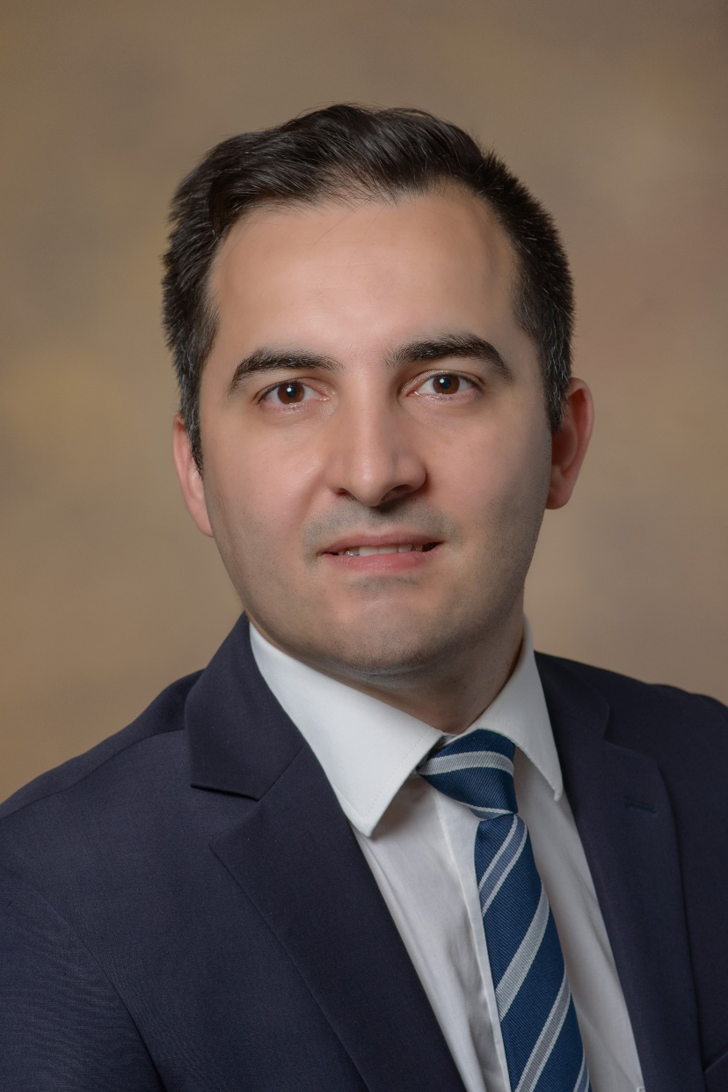
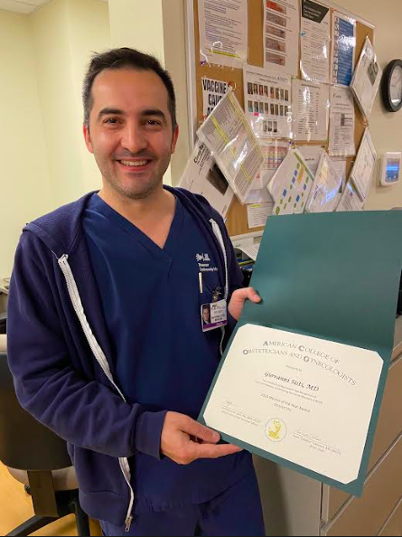
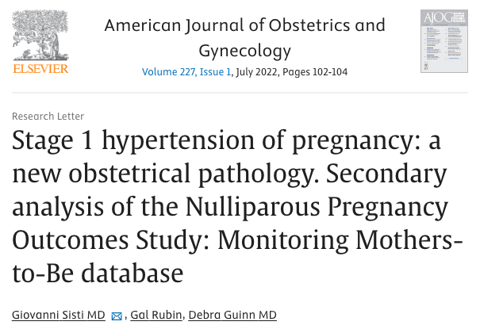
2021 - 2024: Giovanni Sisti, MD
2024 ACOG Mentor of the Year Award, District VIII

Slide 20
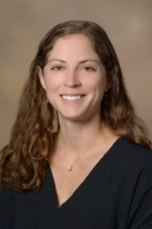
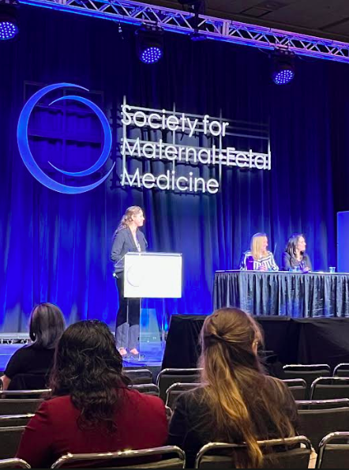
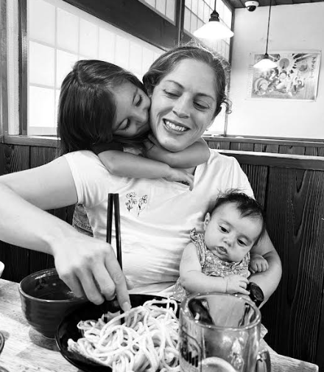
2022 - 2025: Laura Mroue, MD
Residency: Detroit Medical Center/Wayne State University
Thesis: Fitbit device use in overweight pregnant women to improve adherence to gestational weight gain guidelines

Slide 21
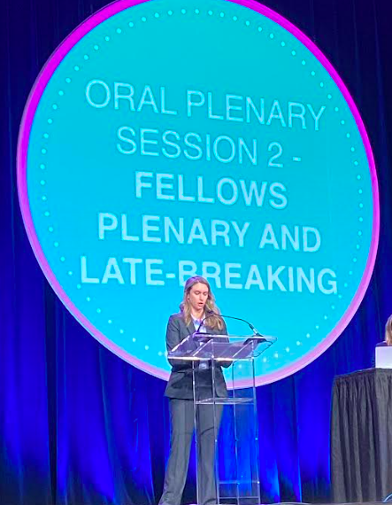
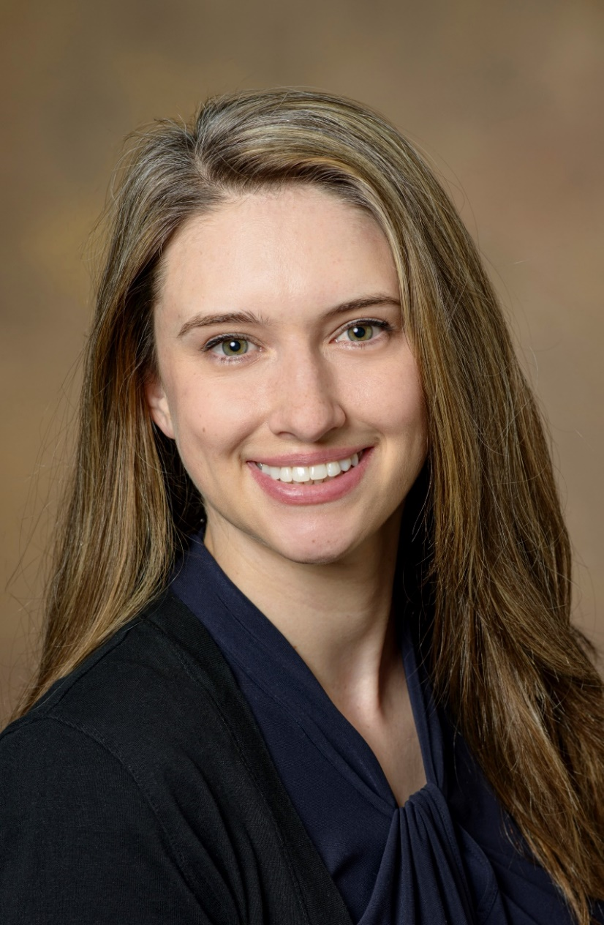
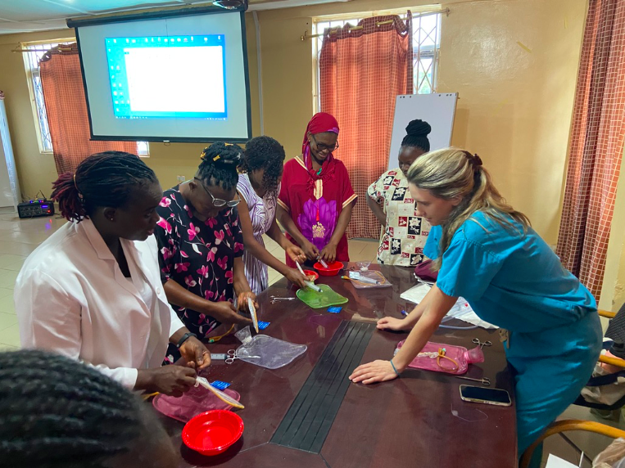
2023 - 2026: Amanda McWhirter, MD
Residency: University of Arizona Tucson
Thesis: The Effect of Enhanced Recovery After Surgery (ERAS) on Neonatal Glucose: A Randomized, Equivalence Trial

Slide 22
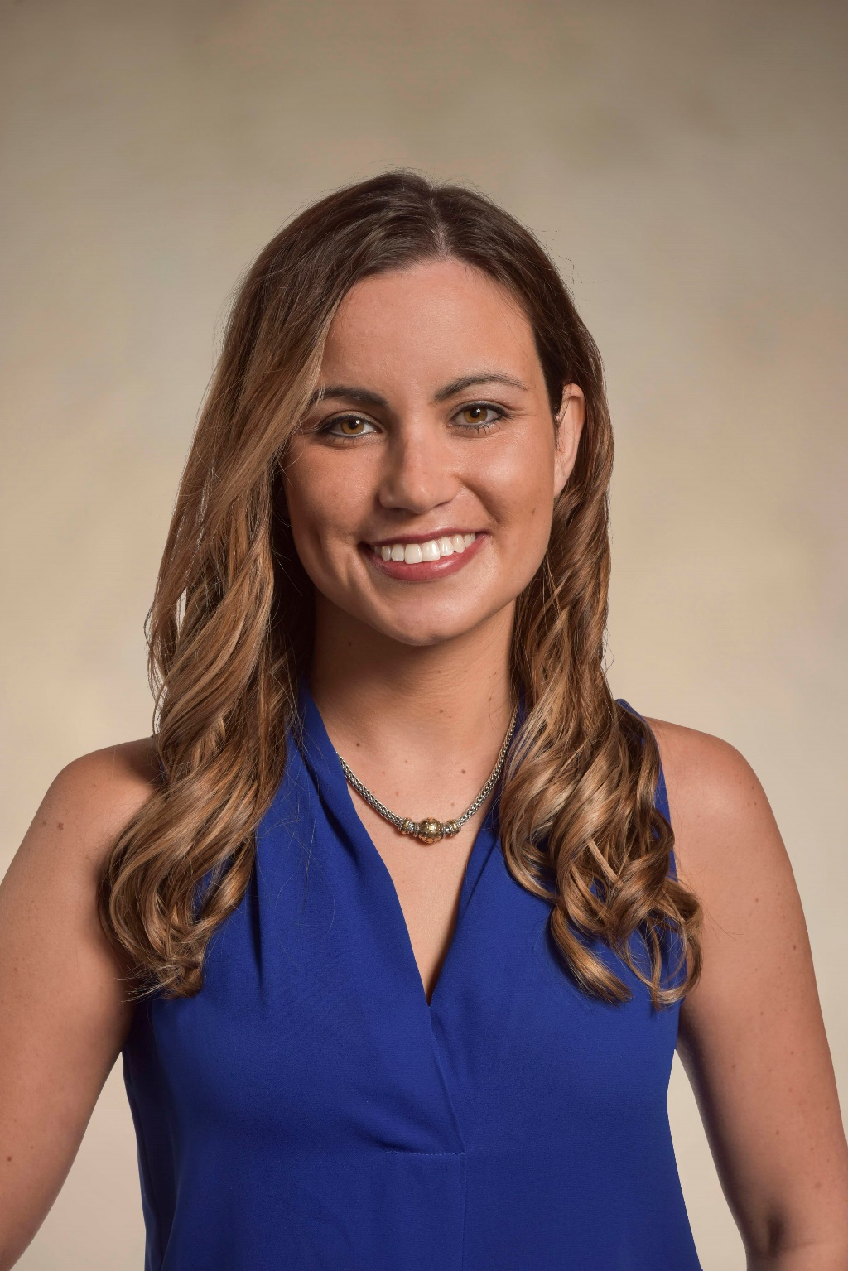
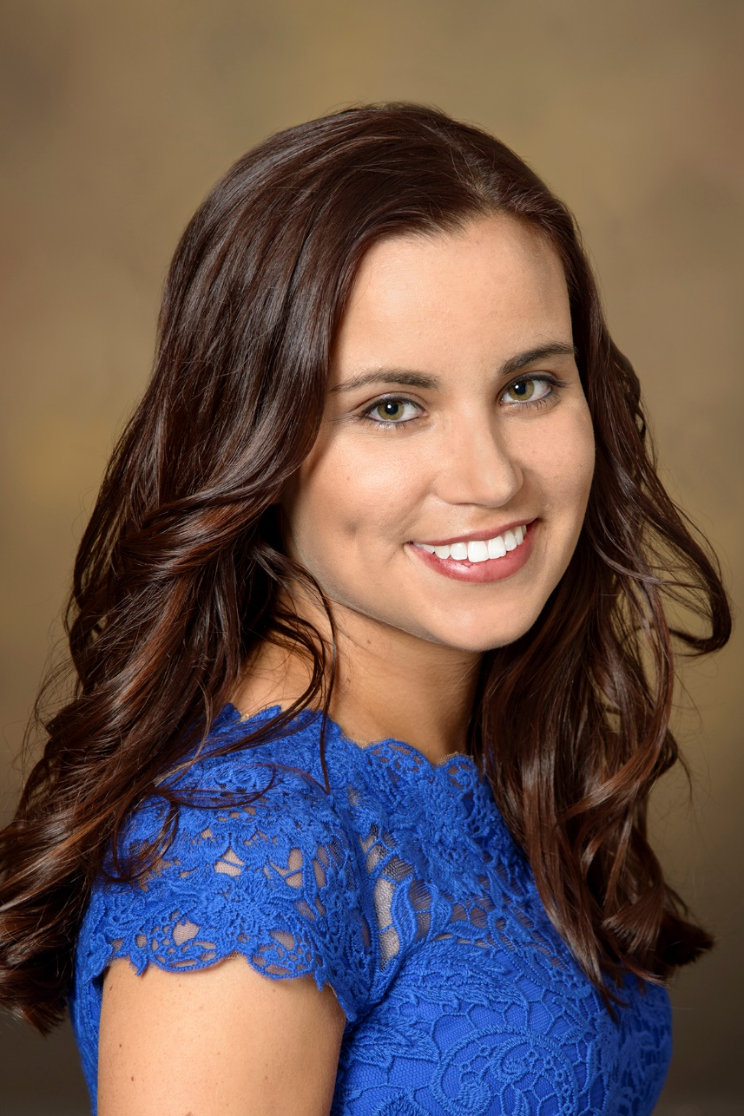
Our newest MFM Fellow: Veronica Winget, MD
Residency: University of Arizona Tucson
Medical School: Tulane University School of Medicine
Hobbies: Adore my family, friends and dog. I enjoy the outdoors, especially spending time hiking, swimming, kayaking, boating and diving. On a quiet day, I enjoy eating good food, especially Thai or Sushi, reading and watching movies.
Initial Interests: Pre-eclampsia, Placental biology, Sleep

Slide 23
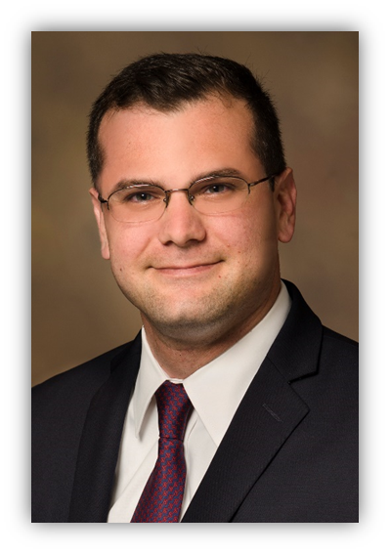
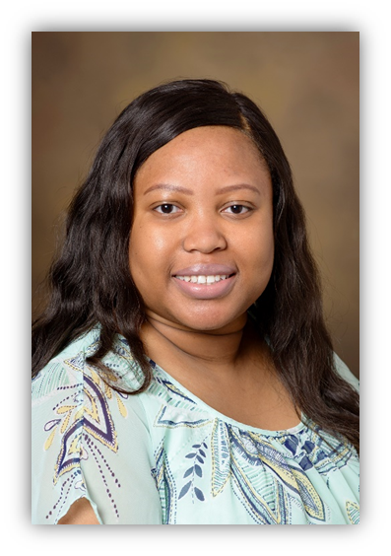
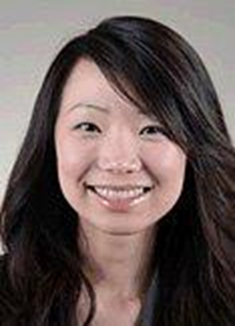
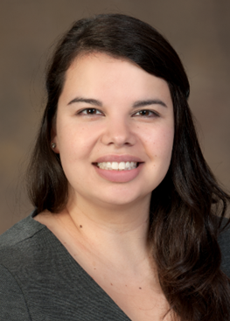
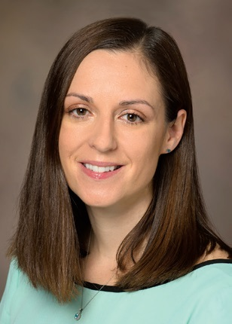
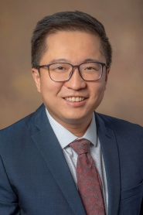
Previous MFM Graduates
Ruth Wei, MD
Seattle MFM
Maritza Gonzalez, MD
University of Chicago
Kareem Tabsh, MD
California MFM
Adeola Awomolo, MD
Houston, TX
Heather Miller, MD
Salt Lake City, UT
Dawei David Wang, MD
Buffalo, NY
Giovanni Sisti, MD
Billings, MT

Slide 24
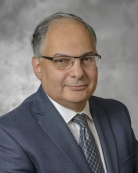
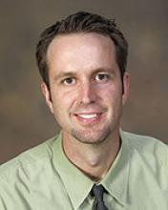
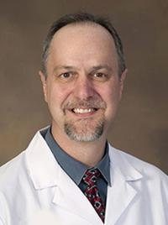
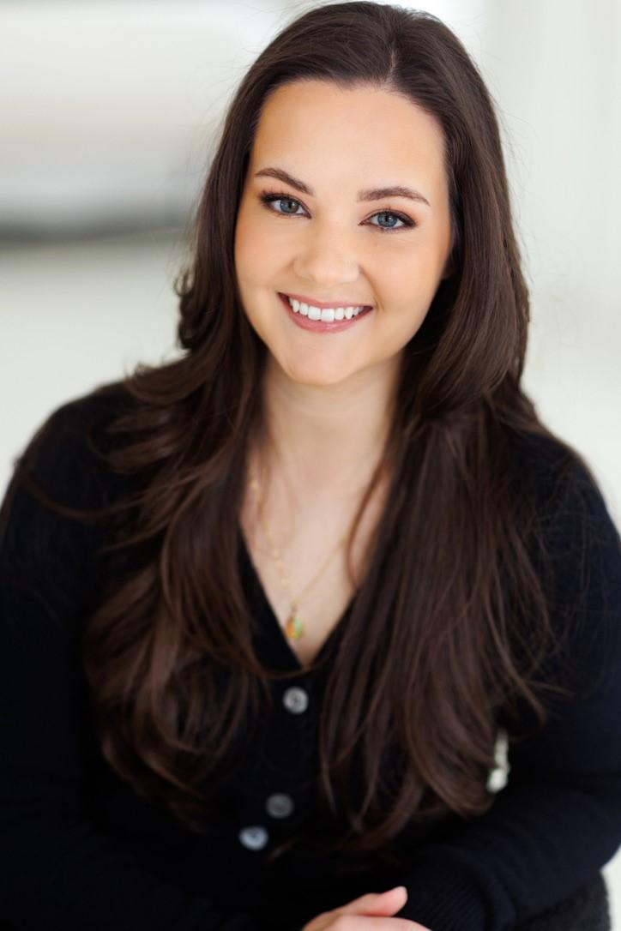
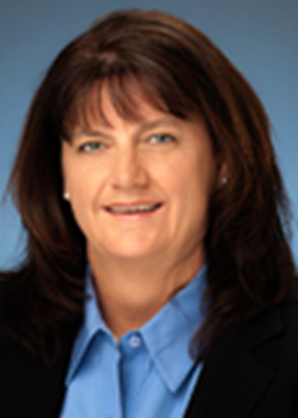
Other Fellowship Faculty
Mohamed Ahmed, MD, PhD
Division Chief
Associate Professor
Arizona Elks Endowed Chair in Neonatology
Brent Barber, MD
Pediatric Cardiology
Fetal Echocardiography
Neuromuscular Cardiac Disorders
Alexandra Burrows, MS, CGC
Prenatal Genetic Counselor
Obstetrics & Gynecology
Gina Connelly, MD
Community-based MFM practice
Tucson Medical Center
Scott Klewer, MD
Professor of Pediatric Cardiology
Professor, Cellular and Molecular Medicine
Professor, Medicine

Slide 25
Other Fellowship Faculty
Melissa Furlong, MD
Assistant Professor, School of Public Health
Ravi Goyal, PhD
Professor, and Vice Chair of Research, Obstetrics & Gynecology
Michael Harris, MD
Professor, Immunology, Director, Arizona Health Sciences Center Biorepository
Elizabeth Juneman, MD
Associate Professor, Medicine & Cardiology
Medical Director, Advanced Heart Failure and Transplantation
Sean Limestand, PhD
Professor, Animal & Comparative Biomedical Sciences
Truc-Anh T Nguyen, MD
Clinical Assistant Professor, OB Anesthesia
Julia Solomon, MD
Director, Fetal Diagnostic Center of Arizona
AIUM Board of Directors
And many more!!

Slide 26
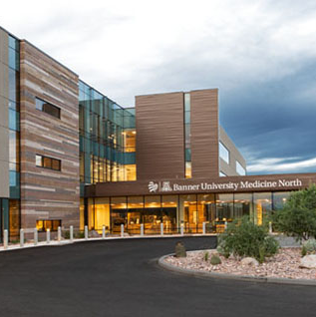
BUMC North Campus
Maternal-Fetal Medicine
10 exam rooms
2 MFM consult rooms
6 ultrasound suites
3 procedure rooms

Slide 27
Our BUMC MFM Team!
MFM Attendings and Fellows
Perinatal Nurse Coordinator
Fetal Diagnostic Center
Social Work
Diabetes Educator
And many more!!
Our overarching goal is to make every patient encounter unique and to provide seamless transitions of care between inpatient and outpatient services and our referring providers.

Slide 28
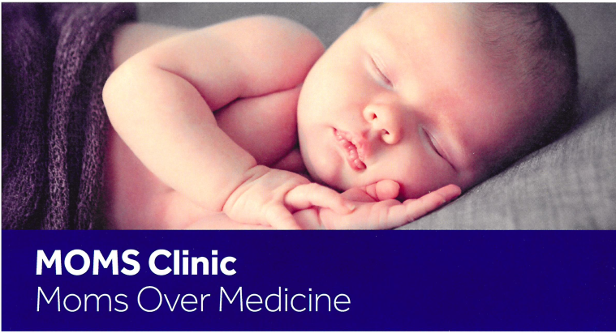
Our Specialty Clinics
MOMS Clinic
Diabetes Clinic
High Risk OB Clinic
Perinatal Ultrasound
Fetal Echo
Perinatal consultations
Genetics

Slide 29
How do we plan on meeting the ACGME and ABOG requirements and still have a well-rounded program?
Requirements: Are better defined but harder to achieve with balance
Our goal for each year: 6 months clinical, 4 months research, and 2 months of electives
Total: 18 months clinical, 12 research, and 6 electives
We are willing to adjust as needed to accommodate research plans and desire to do away electives or travel abroad

Slide 30
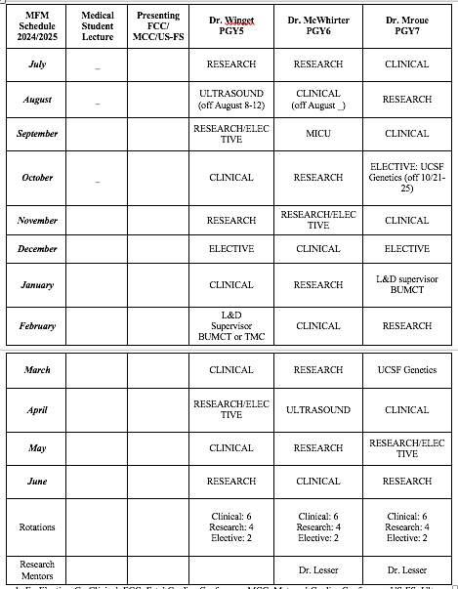

Slide 31
Clinical Rotations (6 months per year)
PGY 5:
1 supervisory role on L+D
1 dedicated US month
4 months clinical fellow (outpatient consults/clinics/1 L+D/genetics/fetal echo/ultrasound)
PGY 6:
1 dedicated US month
1 month ICU
4 months clinical fellow (outpatient consults/clinics/1 L+D/genetics/fetal echo/ultrasound)
PGY 7:
1 supervisory role on L+D
1 dedicated US month
4 months clinical fellow(outpatient consults/clinics/1 L+D/genetics/fetal echo/ultrasound)

Slide 32
Supervisory Role on Labor and Delivery
2 months supervisory role on labor and delivery
1 month first year (TMC or BUMCT)
1 month third year (TMC or BUMCT)
Every Wednesday during clinical block (4 months/year)
Expectation is that the clinical fellow manage all critical care patients or highly medically complex during clinical rotations 24 hours a day

Slide 33
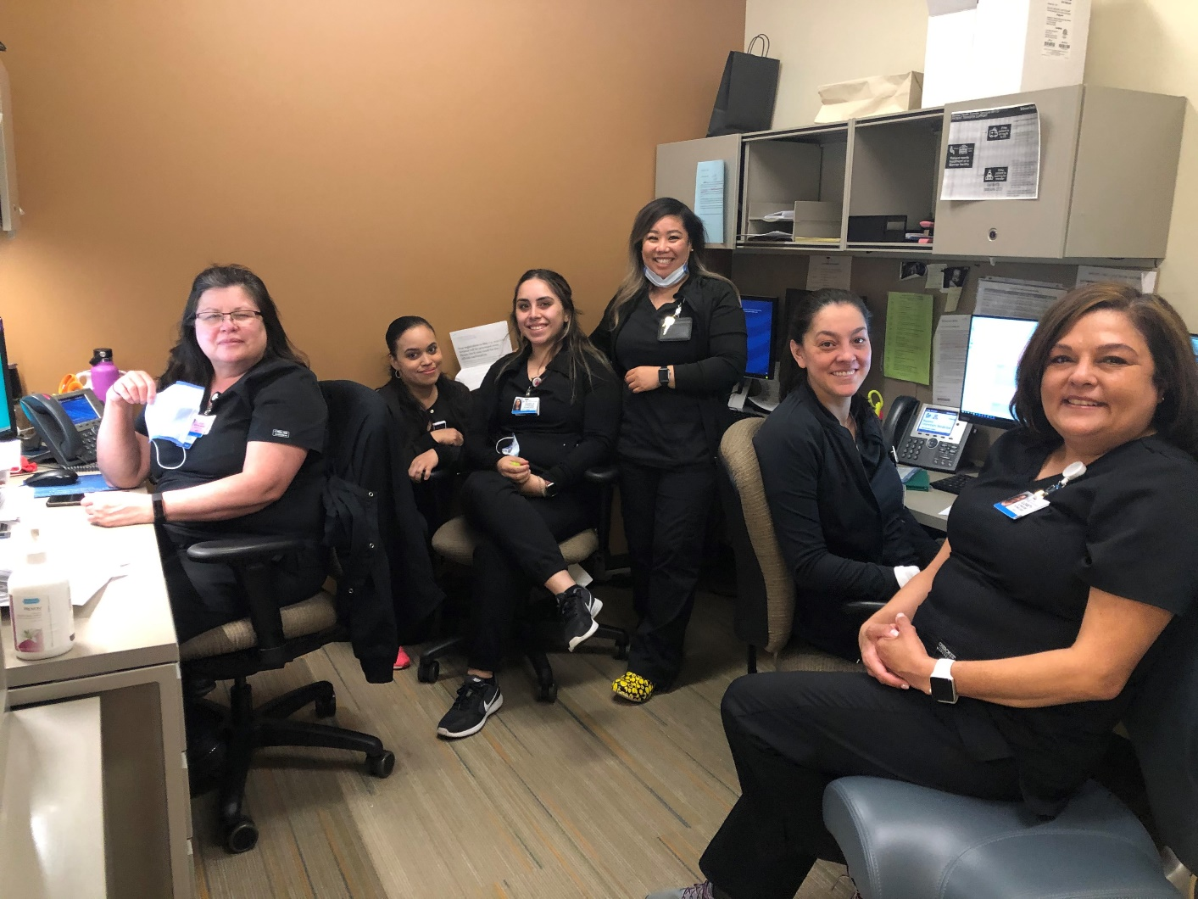
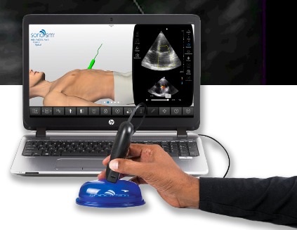
Prenatal Ultrasound
Skill building throughout fellowship
Large volume of patients (and referrals)
At least one month dedicated ultrasound training each year (plus more as desired)
SonoSim (new)
Weekly ultrasound case-based reviews
Option to spend a month with Dr. Solomon in PGY7 year
Each year you will be expected to grow your skills and acquire cases for independent certification including:
NT and first trimester detailed anatomy US
Anatomy survey in singleton and high order multiples
Doppler interrogation
Fetal Echo (BUMC every day, Dr. Barber and Dr. Solomon)

Slide 34
Genetics
Multipronged approach:
PGY 7 Genetics courses through UCSF Center for Maternal-Fetal Precision Medicine
Basic training course in Reproductive Medical Genetics (8-week curriculum in October and March)
On-Site Outpatient Genetic Counseling
Alexandra Burrows, MS, CGD

Slide 35
Research
Block assignment will be based on fellow’s interests, goals, and previous accomplishments
Monthly blocks vs longer dedicated time
Large academic community who wants to work with us
You can carve out your own path! We will make it work as long as it improves women’s health, advances our specialty, and is easily and clearly definable
Additional months of elective can be dedicated to research with Program Director approval

Slide 36
Our commitment to your education
We as a Faculty and University welcome the opportunity to work with our new MFM fellow.
We pledge to do our best to help you accomplish all of your goals in your 3 years with us and beyond.
We have made great strides to adapt our curriculum to meet the ABOG and ACGME fellowship guidelines.
We have a very extensive academic community who embraces the opportunity for our fellows and faculty to help achieve their goals.
We are looking for an MFM fellow who desires to enhance the specialty and women’s care who will be a key member of our team.

Slide 37
Thank you
lcoppola@obgyn.arizona.edu
soniag@obgyn.arizona.edu

