Slide 1
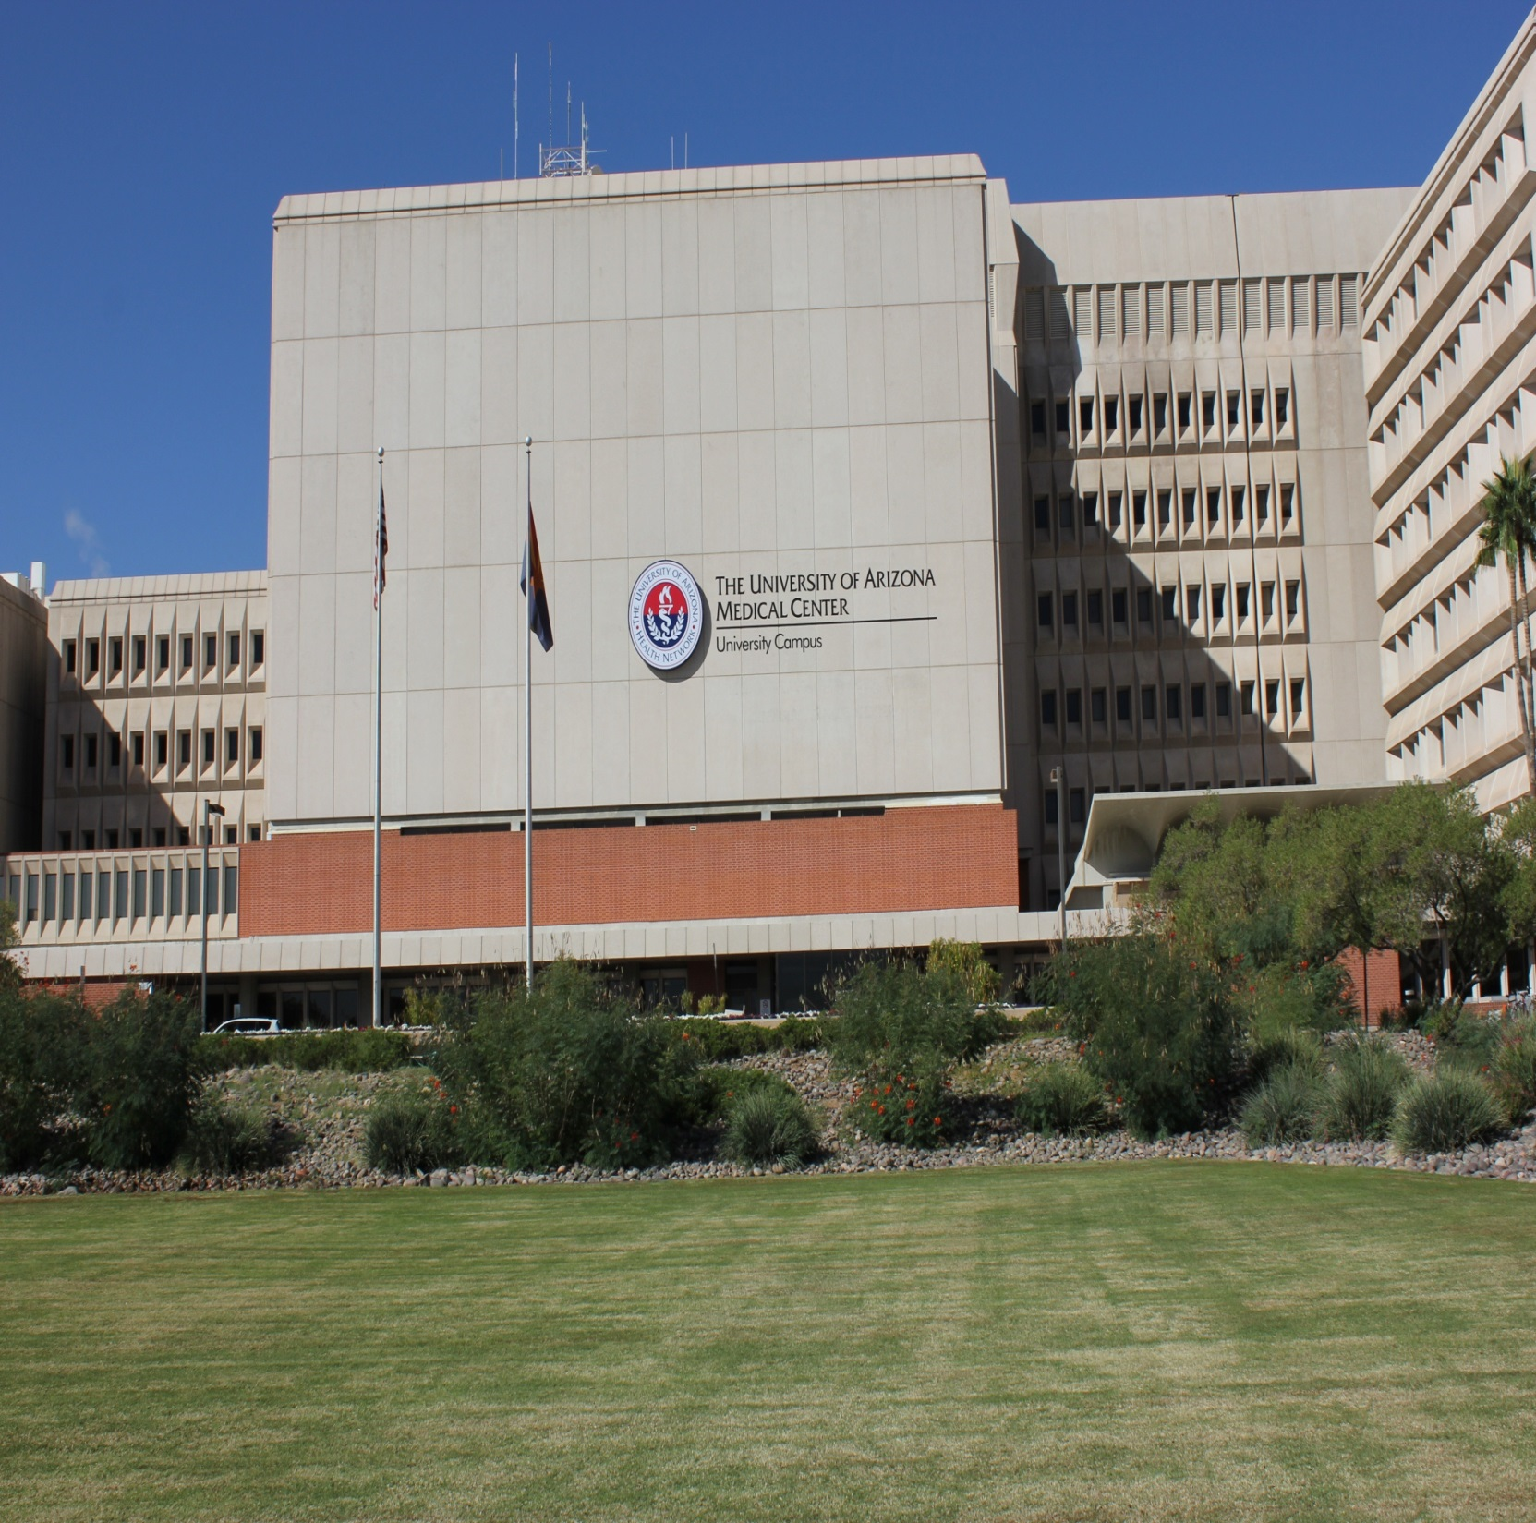
Banner - University Medical Center - Tucson Department of Obstetrics and Gynecology University of Arizona Health Sciences

Slide 3
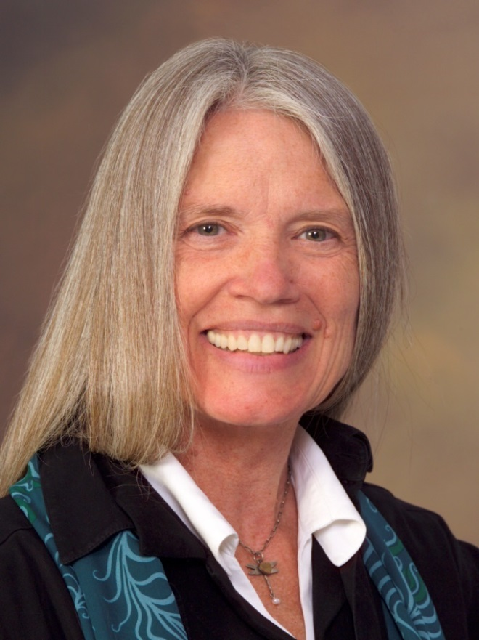
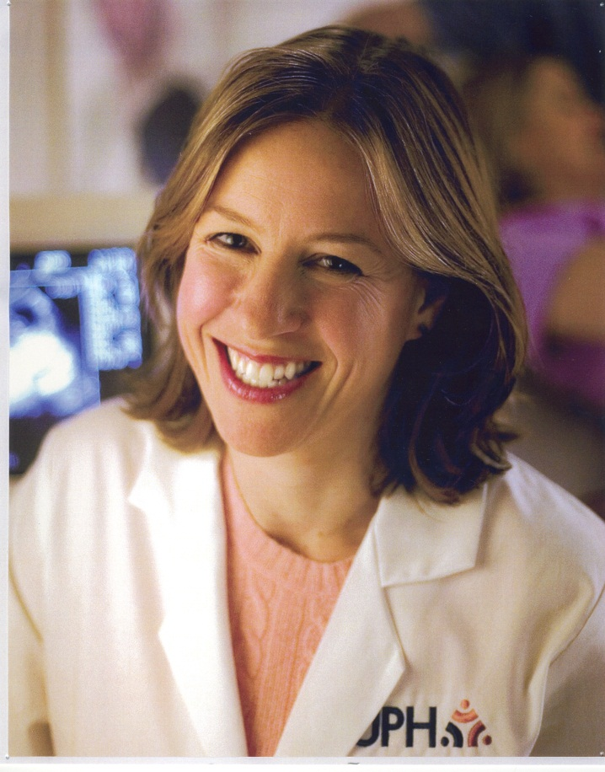
Ob/Gyn Faculty
Kathryn L Reed, MD
Professor and Maternal Fetal Medicine Fellowship Program Director
Ilana B Addis, MD, MPH
Associate Professor and Interim Department Head

Slide 4
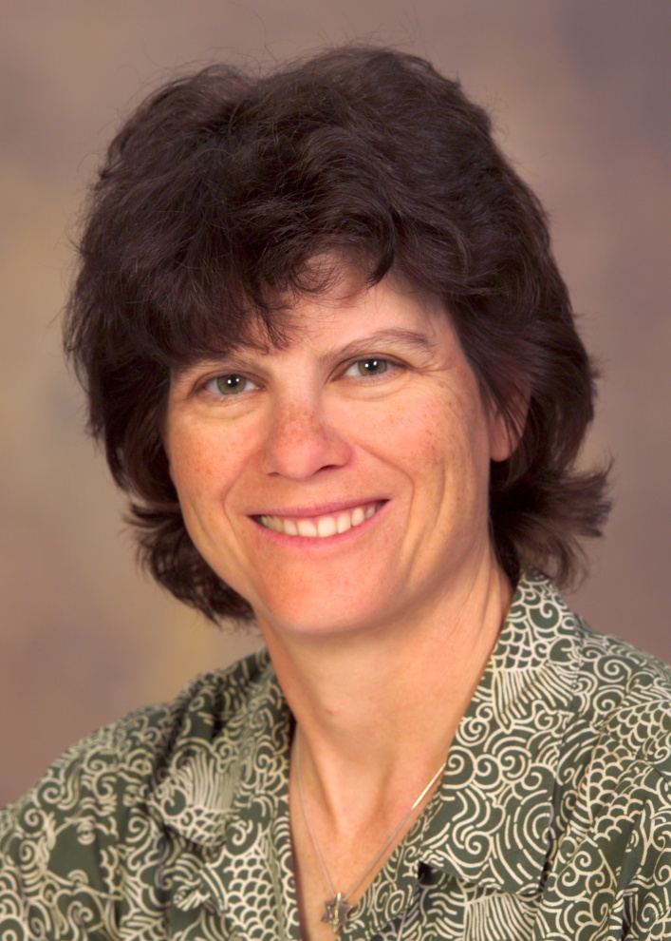
Maternal Fetal Medicine
Lynn Coppola, MD
Meghan Hill, MBBS
Karen Lesser, MD
Kathryn Reed, MD
Maritza Gonzalez, MD
Kareem Tabsh, MD
Adeola Awomolo, MD
Nydia Borjon, RDMS
Meghan Doyle, RDMS
Yasmin Etebar, RDMS
Robin Miller, RDMS
Christine Schmidt, RDMS
Anca Poputa, RDMS
Lori Gaudette, RDMS
Karen Lesser, MD
Division Director

Slide 5
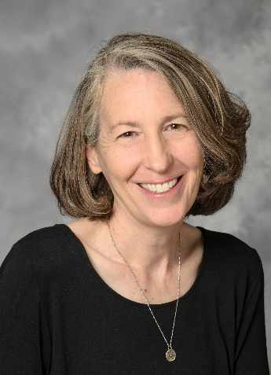
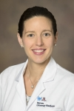
Maternal Fetal Medicine
Kathryn Reed, MD
Karen Lesser, MD
Lynn Coppola, MD, MPH
Meghan Hill, MBBS

Slide 6
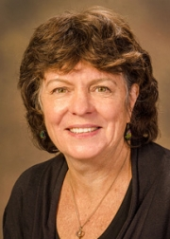
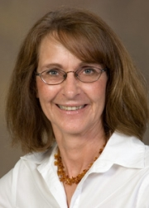
Genetics
Leslie F. Benson, MS, CGC
Dee L. Quinn, MS, CGC

Slide 7
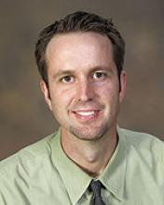
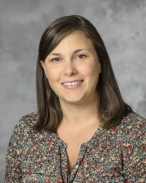
Pediatric Cardiology
Brent Barber, MD Shelby White, MD
Professor Assistant Professor

Slide 8
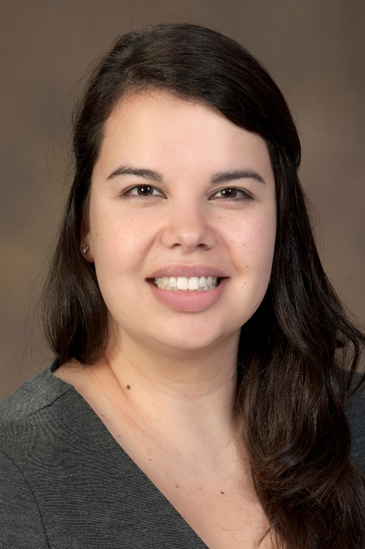
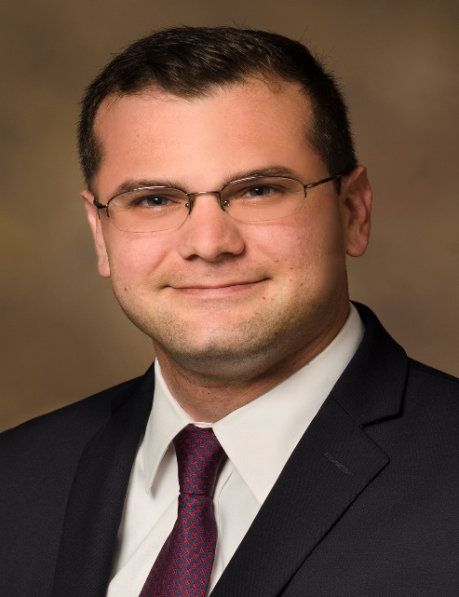
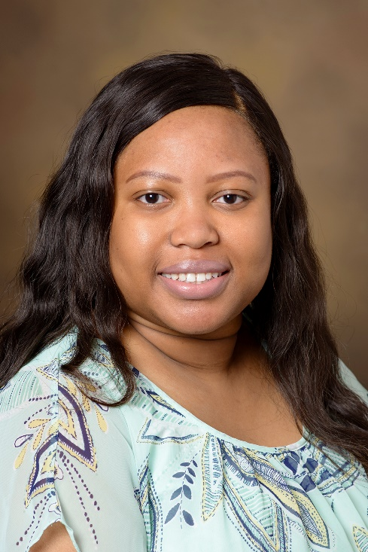
Maternal Fetal Medicine Fellows
Maritza Gonzalez, MD
Kareem Tabsh, MD
Adeola Awomolo, MD

Slide 9
Schedules

Slide 10
ABOG Fellowship Requirements: 36 months
Minimum 12 months in clinical maternal-fetal medicine
Minimum 12 months in research
2 months in an L&D unit
1 month in an ICU
9 months tailored electives in clinical/research area at the discretion of program director
22 vacation days , annually (PTO) - conferences do not count against PTO

Slide 11
 | 1st Year - Awomolo | 2nd Year - Tabsh | 3rd Year - Gonzalez
July | Research | L&D | Research
August | L&D | Ultrasound | Research
September | TMC | Research | L&D
October | L&D | Research | Elective
November | Research | Research | L&D
December | Ultrasound | L&D | North (clinic)
January | TMC | L&D | Research
February | Research | Research | L&D
March | L&D | TMC | Echo/Ultrasound
April | Elective | L&D | Research
May | L&D | ICU | Research
June | Research | L&D | Elective

Slide 12
Adeola: Research
Kareem: Clinical U of A
Maritza: Research
FCC: Fetal Cardiac Conference (700 ObGyn)
PNC: Peri/Neo Conference (1200 ObGyn)
FC: Fellows’ Conference (1300 ObGyn)
DMC: Diabetes Clinic (800-1200 North)
HRC High Risk Clinic (800-1200 North)
Satellite US Clinic (1000-1600 4th floor BUMCT)
Clinic closed through 7/4/18
Clinic Move
Holiday
F.C.C. (Maritza)
HRC
PNC
FC
DMC: Kareem
Satellite US clinic
HRC
PNC
FC – Fellow Lecture (Kareem)
DMC: Kareem
Satellite US clinic
HRC
PNC
FC
DMC: Kareem
Satellite US clinic
HRC
PNC: M&M (Kareem)
FC
DMC: Kareem
Satellite US clinic
HRC

Slide 13
Clinical rotations

Slide 14
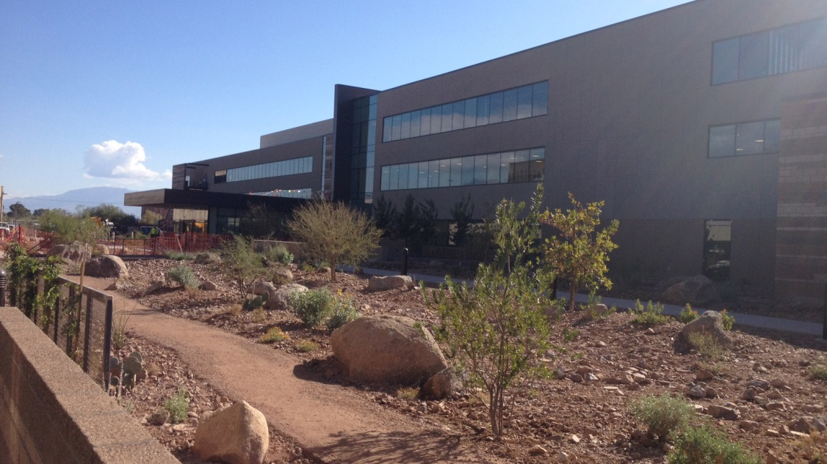
North Campus
3838 N Campbell Tucson, AZ 85719
4 ultrasound suites
3 procedure rooms

Slide 15
Tucson Medical Center Rotation
MFM practice at Tucson Medical Center
Opportunity for research

Slide 16
Elective Rotations

Slide 17
Elective rotations
Fetal Echocardiography
Global Health
Colorado Fetal Care Center

Slide 18
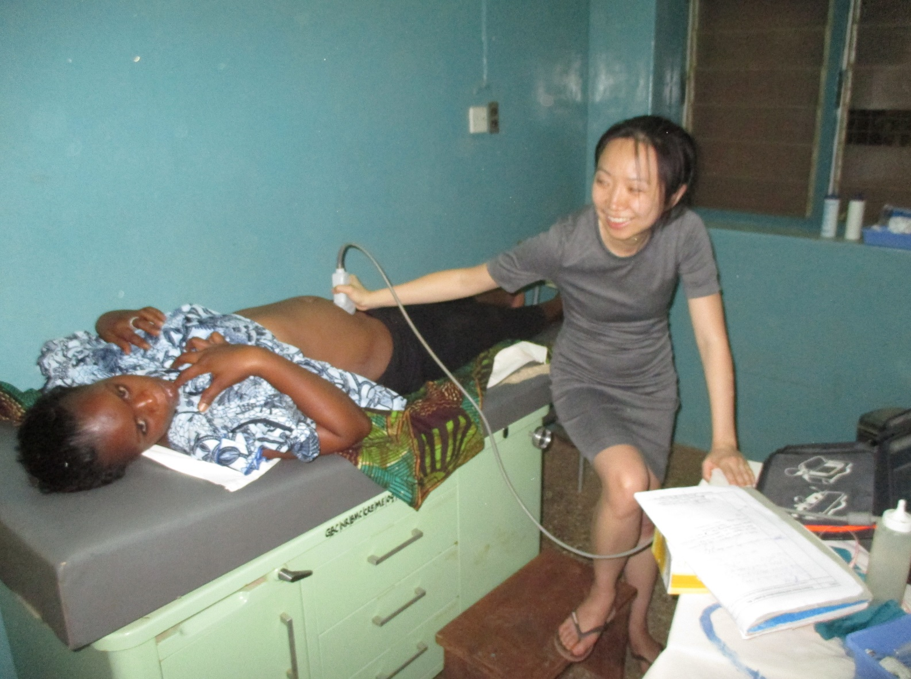
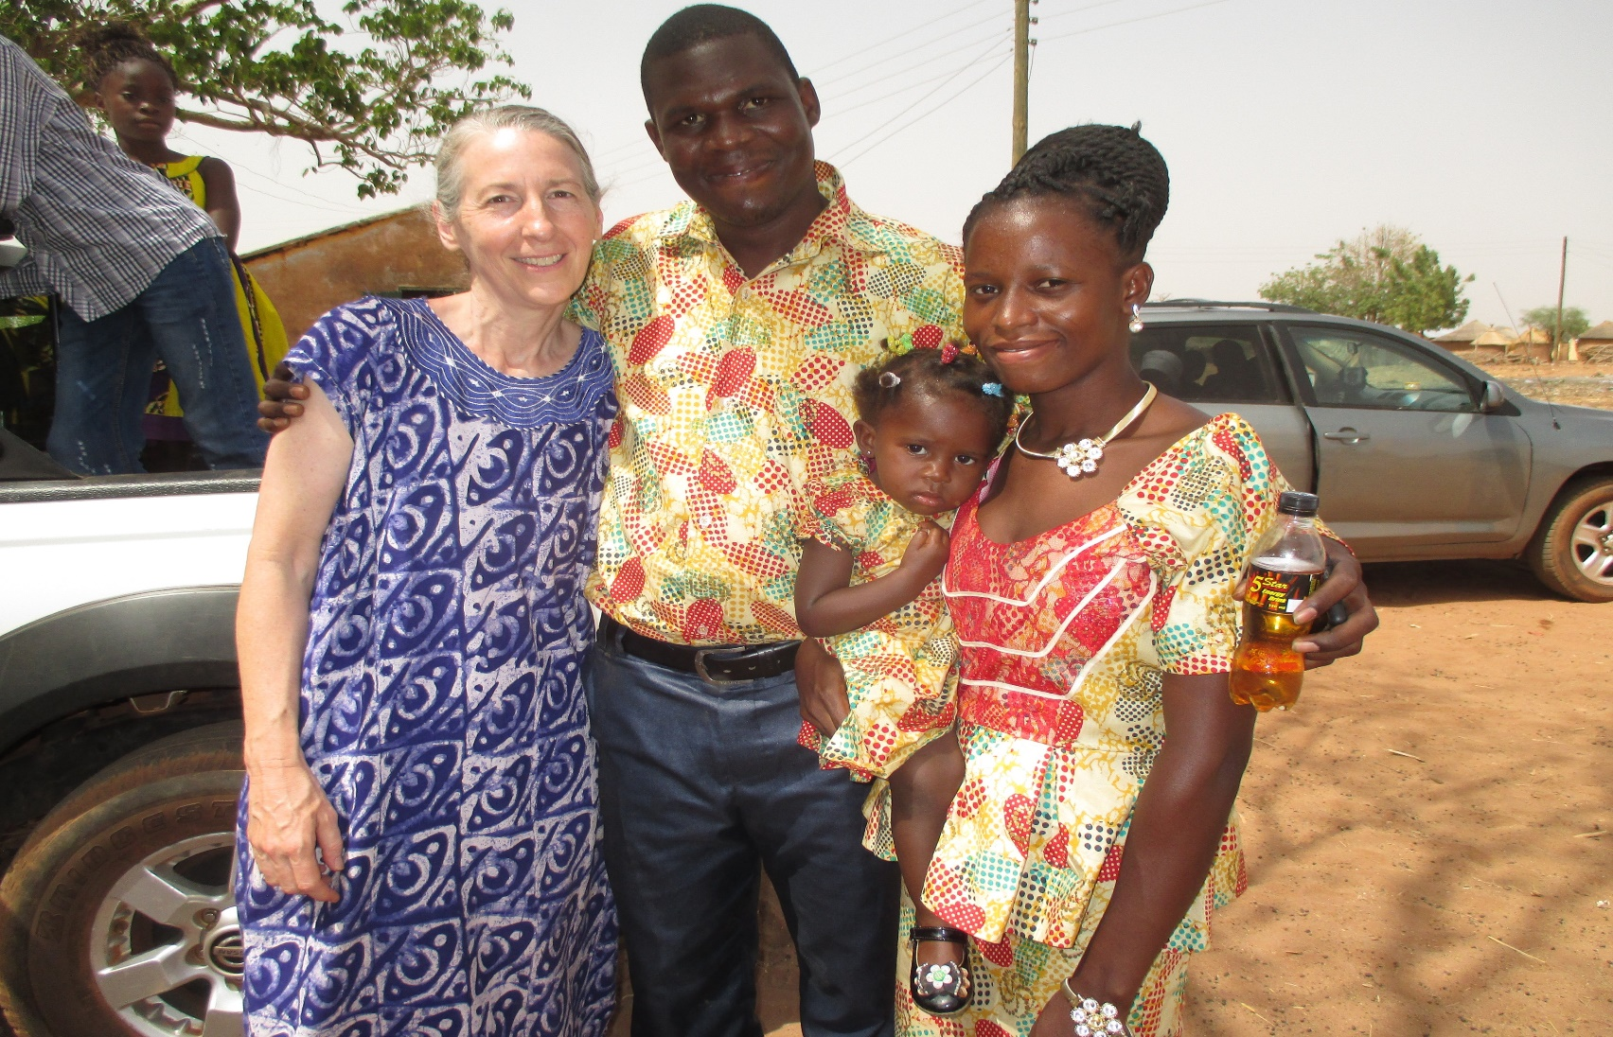
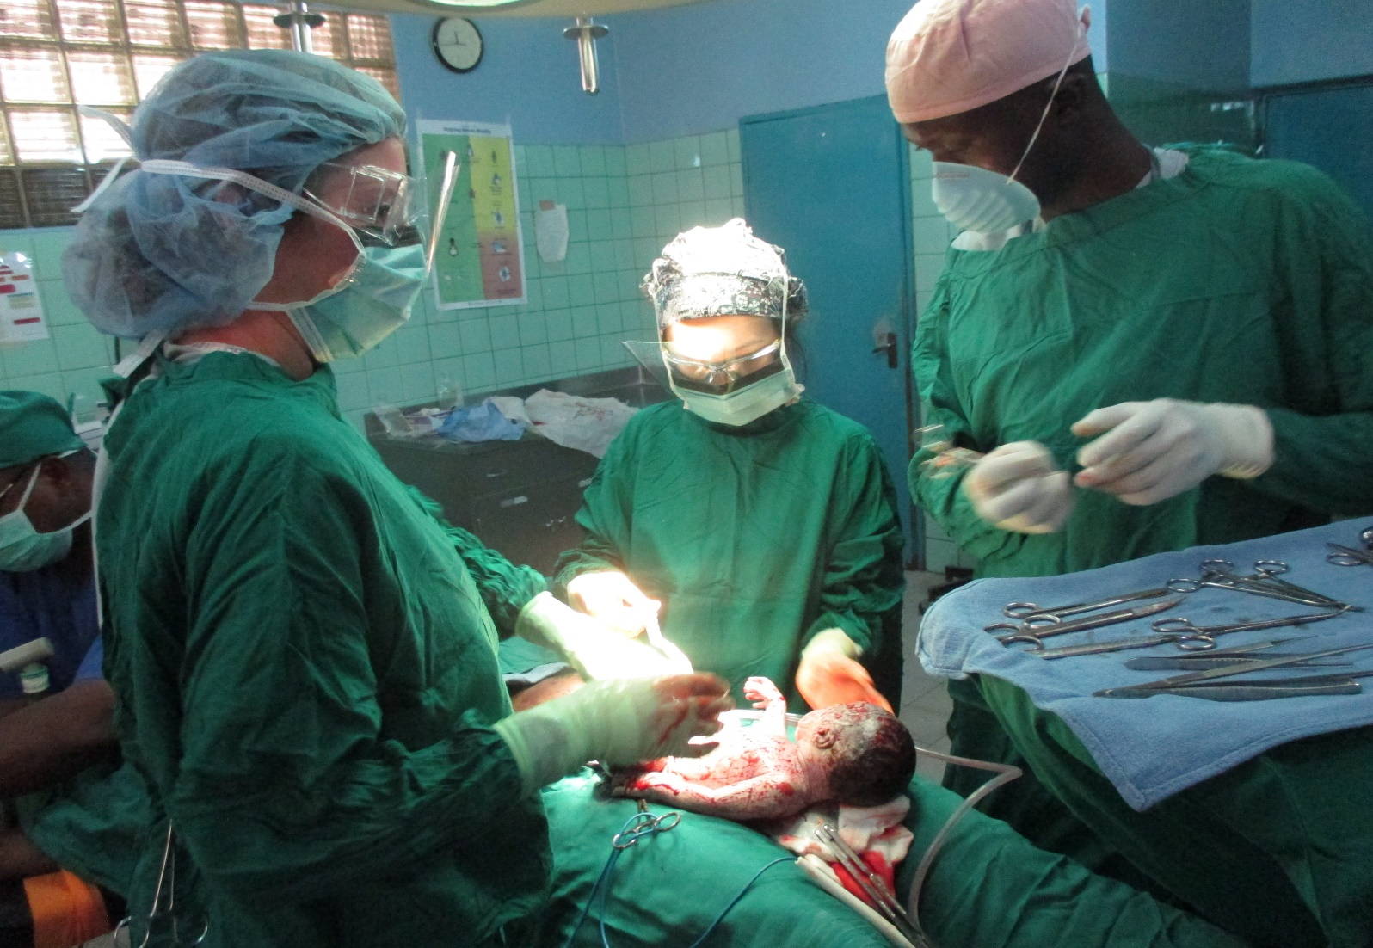
Dr. Coppola in Ghana

Slide 19
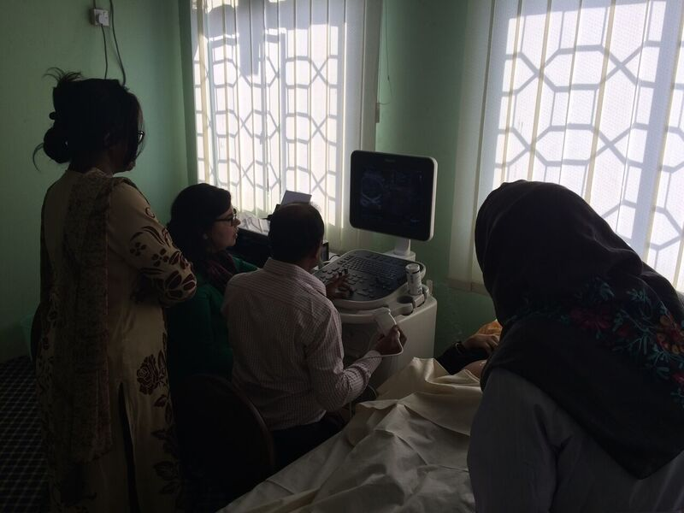
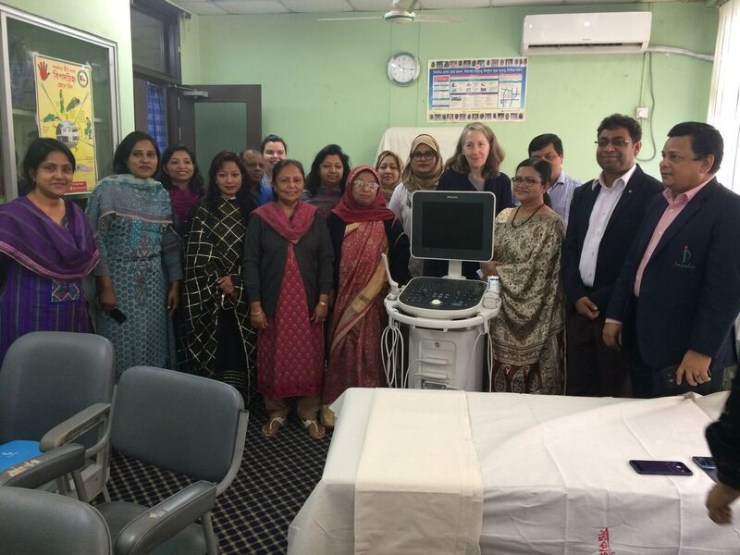
Dr. Coppola in Bangladesh

Slide 20
Research

Slide 21
MFM Research
We currently have 17 open studies
We have three private industry grants
We have one externally-funded grant

Slide 22
Clinical Research
Misoprostol in Addition to a Double-Balloon Catheter for Induction: A Double-Blind Randomized Controlled Trial, Meghan G. Hill, MBBS1 Maritza G. Gonzalez, MD1 Wei-Hsuan Lo-Ciganic, PhD2 Kathryn L. Reed, MD1
High dose vs. low dose oxytocin for labor induction in obese women: a randomized controlled trial – the OPS (Obese Pitocin Study) trial, Ruth Wei, MD
Topical Negative Pressure Wound Therapy to Prevent Wound Complications Following Cesarean Section in High Risk Obstetric Patients, Maritza Gonzalez, MD, Kristine Kjellsson, MD
Performance of the Monica Novii Wireless Patch System in preterm labour, Maritza Gonzalez, MD
Analysis of Longitudinal Strain by 2D Speckle Tracking in Fetuses with Category I, II and III Tracings in Labor, Kareem Tabsh, MD
The PUB (Placenta, Umbilical Cord and Blood) Study, Meghan Hill, MBBS

Slide 23
Research
The PUB (Placenta, Umbilical Cord and Blood) Study, Meghan Hill, MBBS
Diabetes
Intrauterine growth restriction
Prematurity
Cholestasis of pregnancy
Abnormal placentation

Slide 24
Research: Translational
Effects of uncontrolled diabetes on neonatal interventricular septal hypertrophy, Maritza Gonzalez, MD
Cord blood stem cells for neurological protection in premature infants, Meghan Hill, MBBS

Slide 25
Research: Translational
Dr. Sean Limesand joined the Animal Sciences Department 2005
Limesand Lab
Fetal programing
Enviromental physiology
Metabolic endocrinology
Nutrition
Reproductive physiology

Slide 26
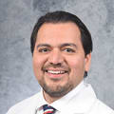
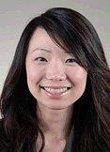
Recent Graduates
Meghan G Hill, MBBS
Tony Hernandez, MD
Ruth Wei, MD

Slide 28
Kim Maxwell Senior Program Coordinator (520) 626-6174
Kmaxwell@obgyn.arizona.edu

Slide 29
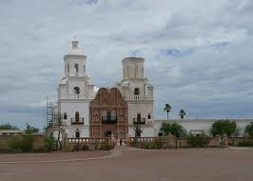
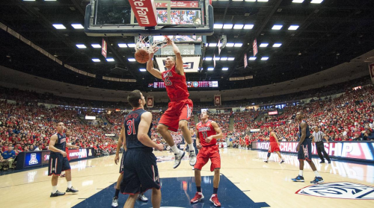
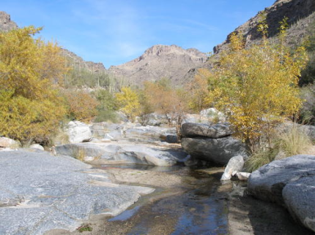
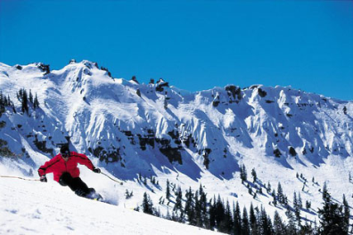
Fast Facts About Tucson/University of Arizona
General Information:
Tucson is now the second-largest city in Arizona after the state capital Phoenix; it is also the county seat of Pima County, which includes the towns of Marana, Oro Valley, Catalina, South Tucson, Sahuarita, Vail, and Green Valley. Metropolitan Tucson's population is more than 1 million.
Tucson is surrounded by five mountain ranges; the Tucson, Santa Catalina, Rincon, Santa Rita, and Tortolita mountain ranges
Tucson is the sunniest city in the United States. Winter temperatures average highs of 64-75 °F.
Housing: Average Sale Price: $216,257
Things to Do:
Arizona-Sonora Desert Museum
Sguaro National Park
Sabino Canyon
Colossal Cave Mountain Park
Mt. Lemmon
Pima Air & Space Museum
Mission San Xavier
Tohono Chul Park
Old Tucson Studios
Tucson Botanical Gardens
Biosphere
Kitt Peak National Observatory
Kartchner Caverns State Park
The Fox Tucson Theatre
Tucson Symphony Orchestra
Arizona Theatre Company
Centennial Hall
Arizona Opera
Ballet Tucson
Tucson Jazz Society
Galleries
Callaghan Vineyards
Carlson Creek Vineyard & Wine Tasting
Charron Vineyards & Winery
Bicycle Friendly: 630 miles of striped bike paths 72 miles of shared use paths Over 100 miles of residential bike routes Over 300 miles of mountain biking trails
El Tour De Tucson – Held annually the Saturday before Thanksgiving, El Tour is a fun adventure ride attracting over 9,000 cyclists of all ages and abilities from throughout the United States and worldwide, consisting of novice, intermediate, advanced, and professional riders.
U of A Athletics :
Arizona Athletics is home to 500 student-athletes who compete in 19 sports. Over the years the UA’s student-athletes have won 18 national team championships and 37 Pac-10 conference team championships.

